Slide 1
Active Delay Bus Journey Modelling
Serene Chongtrakul JMC BEng

Slide 2
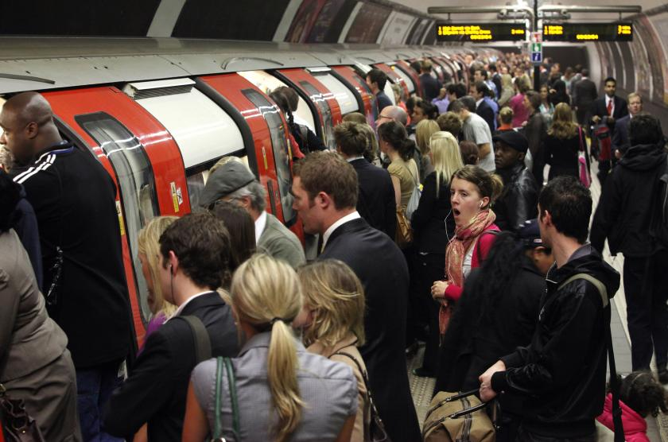
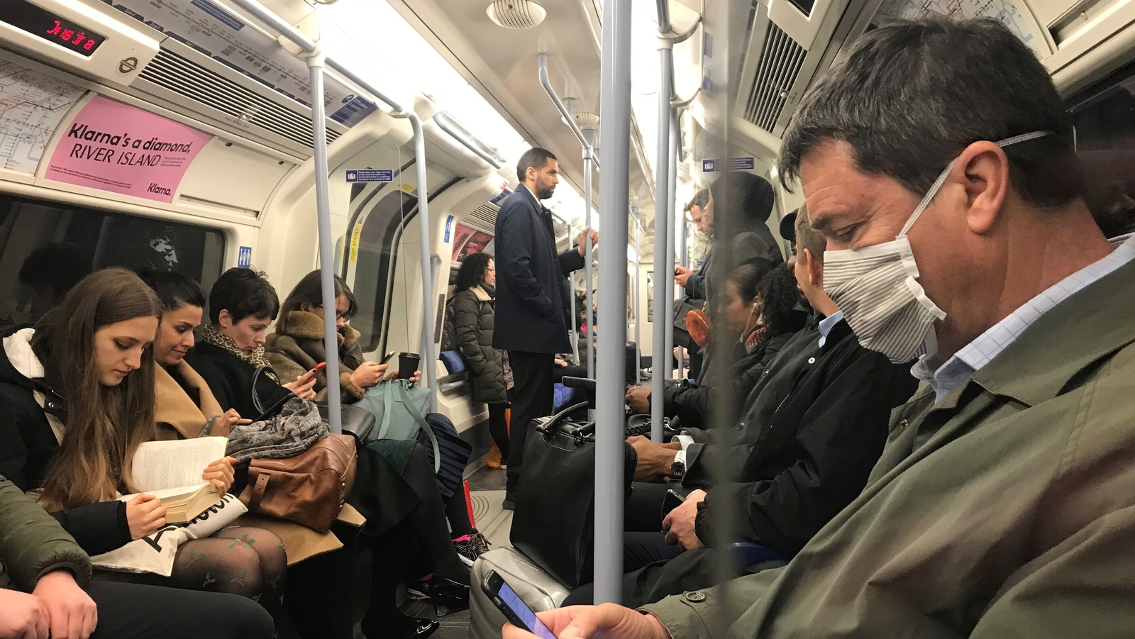
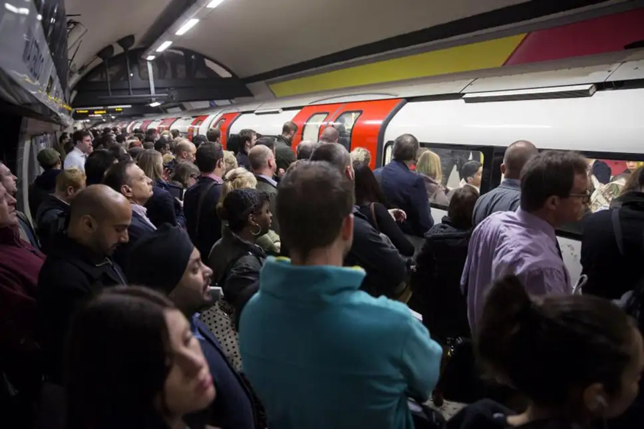
Notes:
I’m not the biggest fan of the tube. At rush hour I find that I’m always stuck at armpit level and I can’t quite reach the handles so it’s a bit of a bet to see if I can keep my balance. But, the tube tends to be a lot more reliable than the bus.

Slide 3
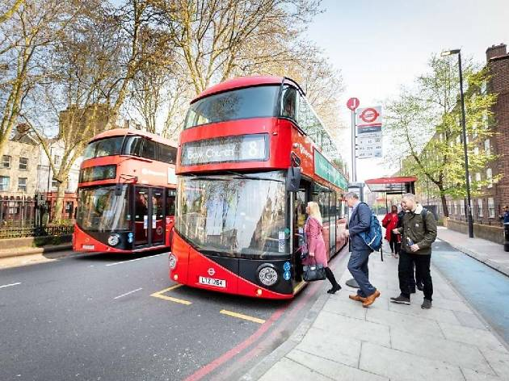
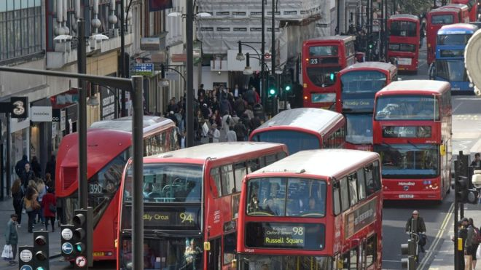
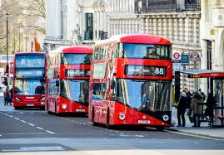
Notes:
Generally, the journey time of the tube will be consistent across all days and times unless there is something like a signal failure that occurs. On the other hand, a bus’ journey time fluctuates a fair amount. I can make the same journey at different times of day and have my journey times be at opposite extremes. For example, there has been an accident on the road and so traffic conditions are slower, causing the bus’ journey time to be longer. This is not the best user experience because I do not know whether taking the bus at any one time will make me late or not. In this project I have created and studied models to try to accurately predict bus journey times in London.

Slide 4


Notes:
You might say, mm doesn’t this already exist. Yes, yes this does exist. Applications such as CityMapper and Google Maps already give you predicted bus journey times that depend on traffic conditions. What makes my models different is that I don’t have access to traffic conditions. My models attempt to still provide good predictions with only access to basic information and by basic information I mean historical bus arrival times and the time of day and day of week that the journey is taking place. Furthermore, the models attempt to actively react to potential delays that occur.

Slide 5
What is a ‘good’ prediction?
Notes:
But what counts as a good prediction? This project used the mean absolute error and the root mean squared error to measure the quality of a prediction.

Slide 6
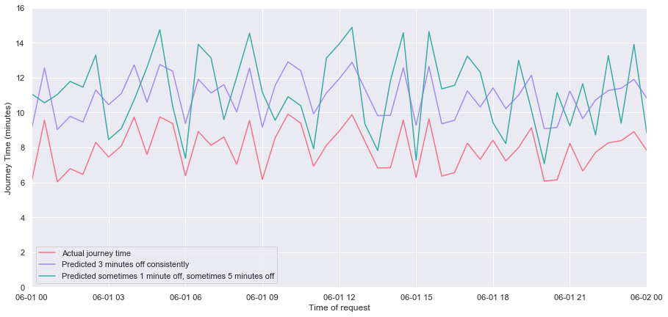
MAE: 2.39, 3.00. RMSE: 3.05, 3.00 (minutes)
Notes:
In the context of bus journey times, the mean absolute error describes how many seconds off the actual journey time a model consistently predicts. On the other hand, since the errors are squared before they are averaged, the root mean squared error gives a relatively high weight to large errors.
Here the pink line is the actual journey time of a bus. The purple line is a model that predicts the journey time to be 3 minutes off consistently. The blue line is a model that predicts the journey time to be 1 minute off 65% of the time and 5 minutes off 35% of the time.
So, is a model that predicts journeys that are consistently 3 minutes off better than a model that predicts journeys that are 1 minute off occasionally and 5 minutes off occasionally? We can see that the according to the mean absolute error, the blue model is better. But according to the root mean squared error, the purple model is marginally better.

Slide 7
Data Collection
TfL Countdown API
130,000 arrival predictions at any point in time [1]
Updated every 30 seconds
Predictions for buses due to arrive in the next 30 minutes
[1] = Tf L Live Bus & River Bus Arrivals API Interface Documentation. http://content. tfl.gov.uk/tfl-live-bus-river-bus-arrivals-api-documentation.pdf. Accessed: 2020-04-30.
Notes:
Before I get started on describing my models, let me first introduce you to Transport for London’s Countdown API. There is no historical bus arrival time data available online so code has to be written to do this manually.
TfL provides an API called Countdown, which gives estimated arrival times of buses across all routes in London. This API is stop centric, meaning you get information related to a particular requested stop. According to TfL, there are approximately 130,000 bus arrival predictions at any point in time [1]. The estimated arrival times are updated at source every 30 seconds and the API returns only buses that are expected to arrive in the next 30 minutes.
This data collection process is actually the part of the project that I found hardest because of the sheer amount of data to digest. I also found it hard to decide how I wanted to store and format the data collected because having not yet developed the models at that point, it was still unclear what kind of information needed to be fed into the models. Some of the design decisions I made here then made life harder for me during the modelling process. For the models, what we want is the journey times between stops not the arrival times of buses at stops.

Slide 8
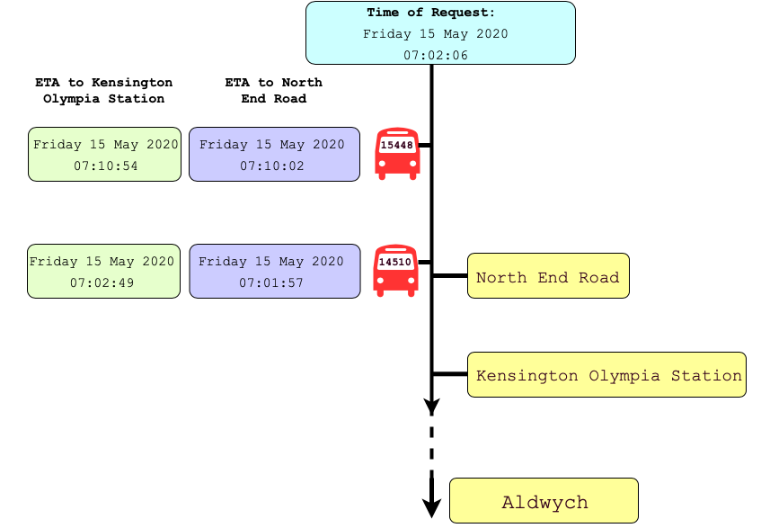
Notes:
Let’s consider the following example to understand how Countdown works. Countdown is called at 07.02 AM for North End Road and Kensington Olympia Station on bus route 9. These two stops are right next to each other. The purple shapes are the response returned by Countdown for North End Road. The green shapes are the response returned by Countdown for Kensington Olympia Station. As you can see from the image, Countdown has returned the same 2 buses for both stops.

Slide 9
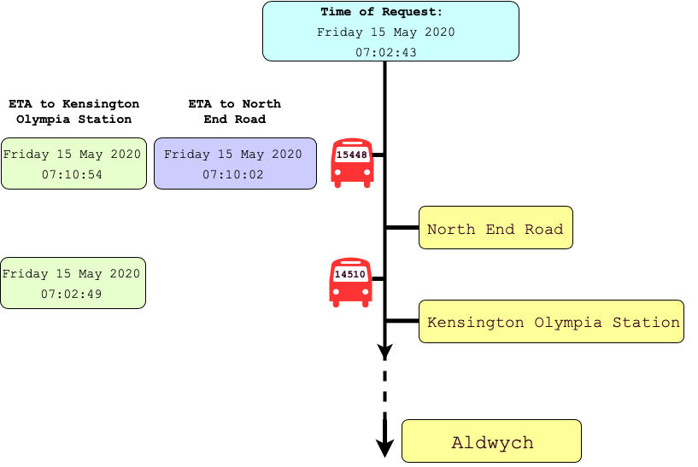
Notes:
Now when Countdown is called approximately 30 seconds later, the first bus is no longer returned in the response, which suggests that it has arrived at North End Road.
We can’t actually assume that the bus that vanished from the Countdown response has actually arrived at the predicted time. Have you sat at a bus stop and the little screen says that the next bus is 5 minutes away and then when it is due, the screen changes and says that it is now actually 2 minutes away. What I mean to say is, TfL’s API isn’t perfect and sometimes it glitches.

Slide 10
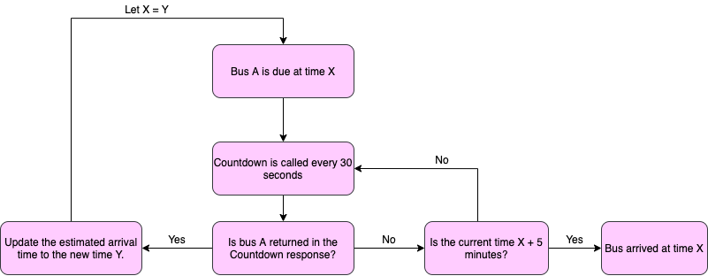
Notes:
So, the following flow chart shows the algorithm the code follows to determine whether a bus has arrived or not. Let the bus be due at time X. Essentially, the code waits 5 minutes until after the bus is due to arrive. It then checks if the bus is returned in the Countdown response. If it is not returned, then it is inferred to have arrived at the time X. If it is returned within those 5 minutes, then this means that it has a new expected arrival time that is after time X.

Slide 11
Quick demo
Notes:
The focus of this project wasn’t on making an application that rivals CityMapper, but was on developing and trying to improve the predictions. However, a very simple mobile application has been developed in order to provide a more user friendly way of showcasing the results from the models. The use case being, I’ve gotten onto a bus at stop A and I want to go to stop B on this route and I want to know how long that journey will take. It should be noted that the predicted journey is for now, i.e. assuming that I’m getting on to the bus now or have just recently gotten onto the bus.
//demo
So here is the application. Let’s say it’s raining and I’m lazy and I don’t want to walk to my friend’s place, so I get the bus instead. I want to know how long it will take me to get there. I go from North End Road, where all the Imperial students live to Phillimore Gardens because my friend had a bigger housing budget than me on bus number 9. According to my model, my journey time is going to be X minutes. Now you can also see that there is another prediction below, which is the amount of time that TfL thinks the journey will take. Let’s try a longer journey. Say I want to go from Willesden Bus Garage to SOMEWHERE where the journey is around 20 minutes.
We should note that Countdown only provides predictions for buses that are due to arrive in the next 30 minutes. This means that if a journey is longer than 30 minutes, Countdown cannot provide this prediction. Their prediction is done by looking for the matching bus vehicle id in the 2 responses returned. So if I put in predictions between stops that are that far apart, my app will return my model’s prediction and a NaN for Tfl’s predictions.
Let me now talk you through what my model is and how it works.

Slide 12
Combined regression & weighted average model
Hypothesis: bus journey time relies equally on global and local factors
Notes:
So the model used is a two part model, where the first part is a regression model and the second part is a weighted average model making use of recent historical data. The hypothesis is that the journey time of a bus relies equally on both `global’ and `local’ conditions.

Slide 13
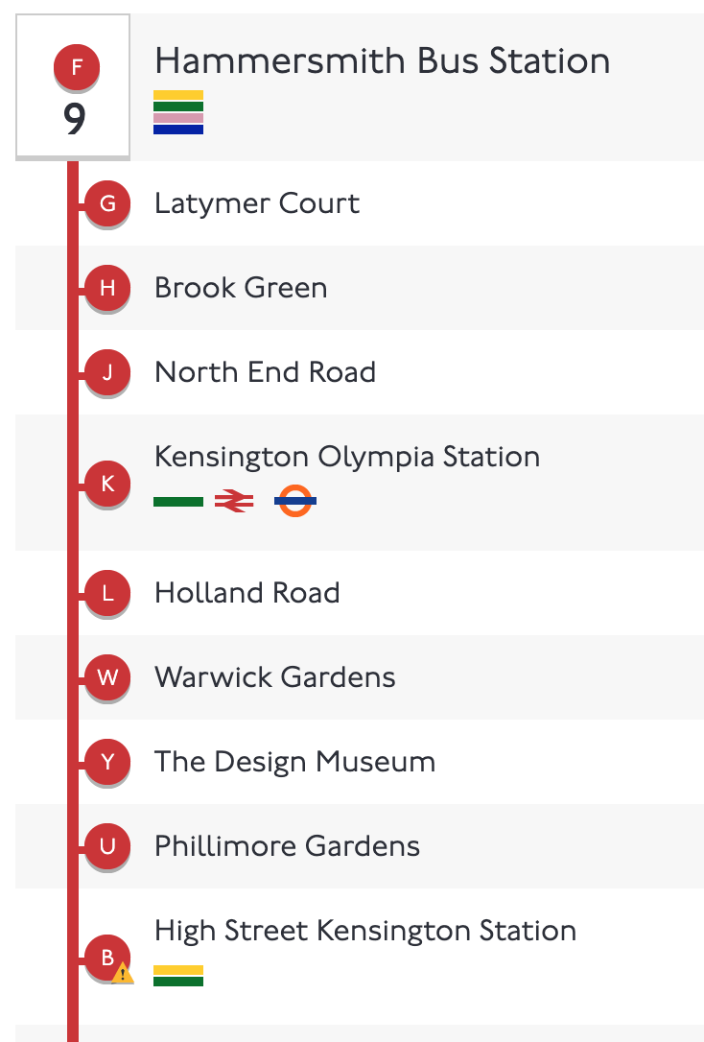
Global vs Local
last 10 journey times
3.4 minutes
4.2 minutes
3.3 minutes
3.6 minutes
4.0 minutes
3.8 minutes
3.9 minutes
4.1 minutes
3.5 minutes
4.1 minutes
Notes:
By `global’ I mean factors such as the time of day or the day of week or how far apart the stops are. It is assumed that these `global’ factors have a consistent effect on the journey time of the bus throughout history. When I say `local’ factors I mean recent journey times that could indicate an increase or decrease in journey times. For example, it is assumed that the general trend in travel conditions is more or less the same every weekend - this is a `global’ condition. However, if on a particular weekend there is a car crash in the morning that causes all bus journeys in the morning to be longer than other weekends, this is a `local’ condition.

Slide 14
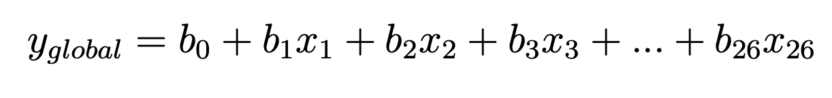
Gap size
Day of week
Time of day
Global prediction
Notes:
The first part of the model is the regression model that predicts the journey time of a bus from stop A to stop B based on the `global’ conditions. The chosen factors are the gap size between the stops, the day of week, which in this equation is a binary value with 0 representing weekdays and 1 representing weekends and the time of day, which has been one hot encoded. So in this equation x_3 is the 0th hour of the day i.e. between midnight and 1 am all the way up to x_26 is the 23rd hour of the day, i.e. between 11pm and midnight. This part is pre-trained on historical data and the coefficients and intercept found are stored so that the numbers just need to be plugged in when a request is made.

Slide 15

Local prediction
Notes:
The second part of the model is a weighted average model that predicts the journey time based on the last 10 journey times between stop A and stop B. The weights are such that more recent journeys are more significant than further away journeys. This part is calculated every time a request is made.

Slide 16
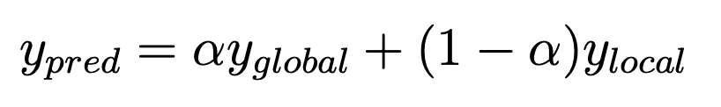
Overall prediction
Notes:
The two parts are then combined as in this equation. During the training process, alpha was tuned using a 2 stage cross validation. Alpha was first varied between 0 and 1, and then I zoomed into the region where the optimal alpha is more closely.

Slide 17
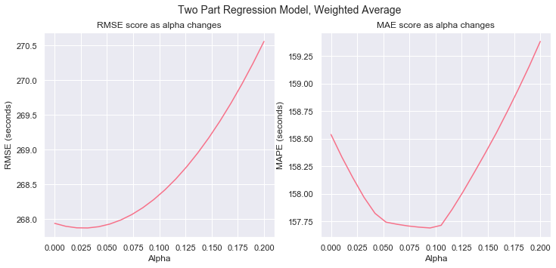
Notes:
So here in this graph we can see alpha varying in steps of 0.01 from 0 to 0.2. The optimal alpha is the lowest dip in the graph. The optimal value of alpha gives us some insight into the relative importance of the global vs local conditions. For this model, the best alpha according to the mean absolute error is 0.094. A value of alpha close to 0 implies that the predicted journey time of a bus relies mostly on the journey times of the recent buses and does not rely as much on global factors such as the time of day or day of week. Which does not support the hypothesis made initially that both global and local factors are equally important.
This model was chosen to be implemented in the app because it outperformed the other models developed as well as outperforming TfL Countdown’s own predictions. According to the mean absolute error, it predicted journeys that were on average about 157 seconds which is about 2 and a half minutes off.

Slide 18
Models
Historical Models
Looking back at the last:
2 buses
5 buses
10 buses
15 buses
Looking back at buses from the last:
15 minutes
30 minutes
60 minutes
2 hours
Combined Regression Models
Regression + weighted average
Regression + line of best fit
Regression + cubic spline
Notes:
In total, 11 models were developed - 8 historical models, 3 combined regression models.
Since an important part of this project is trying to react to things that happen recently, the historical models explore what `recent’ means by looking back different amounts of time and different numbers of buses.

Slide 19
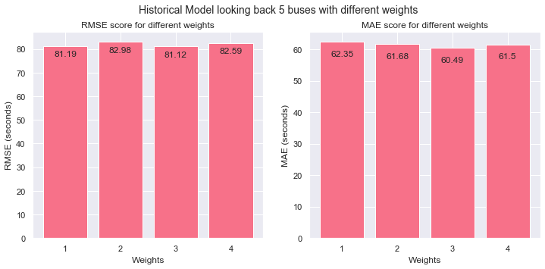
Weight tuning
Notes:
Different weights were considered for the historical models. In this graph, we can see 4 different types of weightings chosen to train the historical model that looks back at the last 5 buses. Weight 1) gave equal weightings to all of the recent journeys. Weight 2) gave much greater weightings to more recent journeys (85% to the most recent 2 buses, 15% to the other 3). Weight 3) gave just a little more weighting to more recent journeys (55% to the most recent 2 buses, 45% to the other 3). Weight 4) gave much greater weightings to journeys that are further away from the request time (35% to the most recent 2, 65% to the other 3). We can see that there isn’t actually very much of a difference between the different weightings, but the third model that gives slightly higher weighting to more recent journeys performs the best, so that kind of weighting was chosen for the all the historical models.

Slide 20
Models
Historical Models
Looking back at the last:
2 buses
5 buses
10 buses
15 buses
Looking back at buses from the last:
15 minutes
30 minutes
60 minutes
2 hours
Combined Regression Models
Regression + weighted average
Regression + line of best fit
Regression + cubic spline
Notes:
The combined regression models explore the relationship between the global and local conditions as mentioned earlier. Obviously one of the combined models is the one combined with the weighted average model. The other two are regression models combined with a line of best fit model and combined with a cubic spline model.

Slide 21
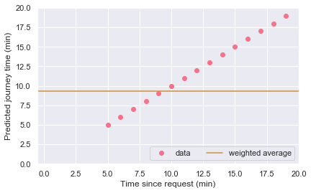
Weighted Average
Notes:
I chose a weighted average model because this was directly building on the historical models that I had developed previously. Furthermore, a weighted average model is good for cancelling out rivalling effects or when data is noisy. However, it does not indicate trends in the data. For example, we can see here that the last 10 journeys are decreasing in journey time and so intuitively we would think that the next journey would be even less. However, a weighted average model is unable to provide such a prediction. Note that the x axis is the time since the request and the y axis is the predicted journey time. So, the point where the x axis is 0 i.e. the y intercept is the desired predicted journey time.

Slide 22
Weighted Average
Notes:
Here is the same graph I showed you earlier, where in the 2nd stage of the cross validation, alpha was tuned between 0 and 0.2

Slide 23
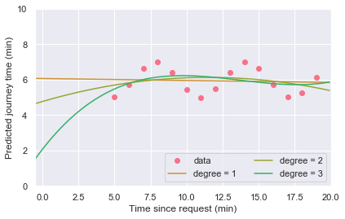
Line of Best Fit
Notes:
On this graph there are linear regression models of degree 1, 2 and 3. A linear regression model of degree 1 essentially becomes a line of best fit. We can see it here with the regression models of degree 2 and 3 the intercept goes to extremes and so provide bad predictions. Therefore, the line of best fit model was the best of the three here.

Slide 24
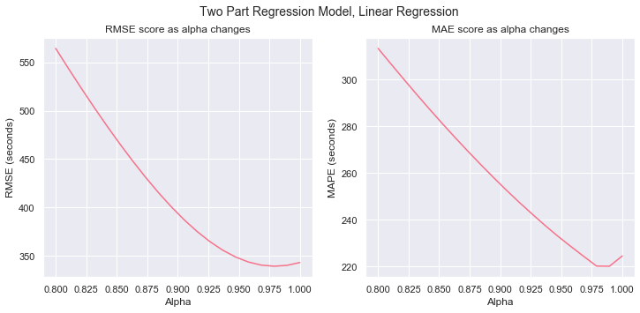
Line of Best Fit
Notes:
This is the second stage alpha cross validation graph. Unlike with the weighted average, we can see that the optimal alpha for the line of best fit is actually closer to 1. This implies that the predicted journey time of a bus relies mostly on the global factors rather than on the journey times of the recent buses. This is the opposite conclusion to what the weighted average model gave us.

Slide 25
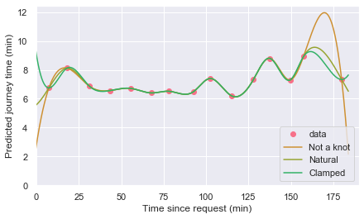
Cubic Spline
Notes:
Here are the three cubic spline models that were used. The difference between them is just the way the boundary conditions are handled. Like with the linear regression models of degree 2 and 3, we can see that the cubic spline models go to extremes at the the end. However, these were considered to be better than the linear regression of degree 2 and 3 because the curves even out more at the ends. In particular, if the recent journey times are further away from the request time, so imagine these points shifted to the right, then we can see that the intercept would be much much larger or smaller than a predicted journey time should be. So it makes sense that this model won’t actually perform well.

Slide 26
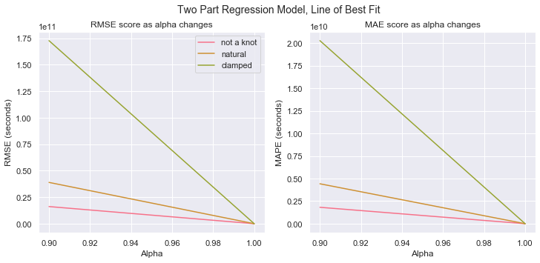
Cubic Spline
Notes:
Look at the alpha cross validation graph for the cubic spline models. We can see that the mean absolute error and root mean square error are huge, values to the power of 10.

Slide 27
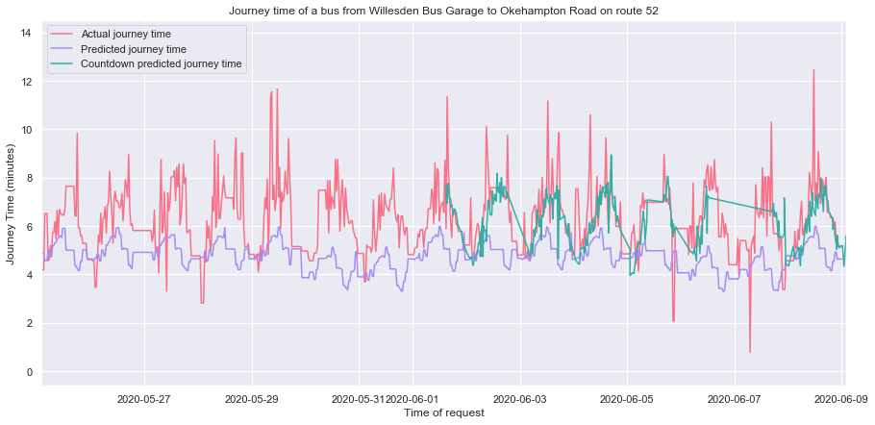
Notes:
Here you can see a graph comparing the actual journey time of a bus to the predicted journey time according to the combined regression model and weighted average model to TfL’s predictions. This is for journeys between Willesden Bus Garage and Okehampton Road on route 52. These stops are also 5 apart.

Slide 28
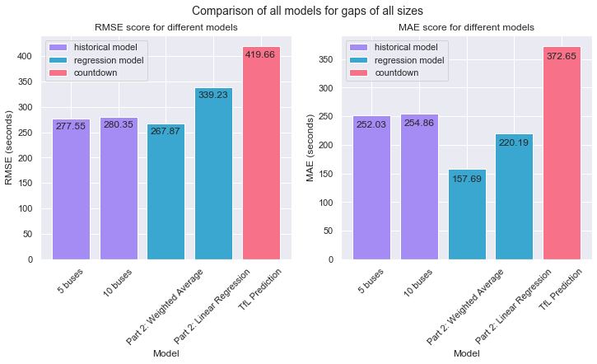
Notes:
Here are the results for the best two performing historical models and the best two performing combined regression models. We can see that all 4 models outperform TfL Countdown’s model on both mean absolute error and root mean square error. This is a great achievement as this was one of the goals of the project and when I first started out, I wasn’t even sure if this was an achievable goal or not.

Slide 29
What next?
Notes:
If I had more time, what would I do next?
Artificial neural networks were a type of model that were used in many of the papers that researched bus journey times. They were not prioritised for this project because given the basic factors that I was studying, I thought there was a high possibility of the ANNs overfitting and being more complicated than necessary. These other papers got their best results from ANNs so it would be interesting to see how an ANN model would compare to the combined regression and weighted average model.

Slide 30
Questions?
Notes:
Overall, I’m happy with the results that the models I developed gave me. That is the end of the presentation, do you have any questions?

Slide 31
Notes:
Introduction
I’m not the biggest fan of the tube. At rush hour I find that I’m always stuck at armpit level and I can’t quite reach the handles so it’s a bit of a bet to see if I can keep my balance. But, the tube tends to be a lot more reliable than the bus. Generally, the journey time of the a tube will be consistent across all days and times unless there is something like a signal failure that occurs. On the other hand, a bus’ journey time fluctuates a fair amount. I can make the same journey at different times of day and have my journey times be at opposite extremes. For example, there has been an accident on the road and so traffic conditions are slower, causing the bus’ journey time to be longer. This is not the best user experience because I do not know whether taking the bus at any one time will make me late or not. In this project I have created and studied models to try to accurately predict bus journey times in London.
You might say, mm doesn’t this already exist. Yes, yes this does exist. Applications such as CityMapper and Google Maps already give you predicted bus journey times that depend on traffic conditions. What makes my models different is that I don’t have access to traffic conditions. My models attempt to still provide good predictions with only access to basic information and by basic information I mean historical bus arrival times and the time of day and day of week that the journey is taking place. Furthermore, the models attempt to actively react to potential delays that occur.
What is a good prediction
But what counts as a good prediction? This project used the mean absolute error and the root mean squared error to measure the quality of a prediction. In the context of bus journey times, the mean absolute error describes how many seconds off the actual journey time a model consistently predicts. On the other hand, since the errors are squared before they are averaged, the root mean squared error gives a relatively high weight to large errors.
So, is a model that predicts journeys that are consistently 3 minutes off better than a model that predicts journeys that are 1 minute off occasionally and 5 minutes off occasionally? This is fairly subjective.
Countdown API
Before I get started on describing my models, let me first introduce you to Transport for London’s Countdown API. There is no historical bus arrival time data available online so code has to be written to do this manually.
TfL provides an API called Countdown, which gives estimated arrival times of buses across all routes in London. This API is stop centric, meaning you get information related to a particular requested stop. According to TfL, there are approximately 130,000 bus arrival predictions at any point in time [1]. The estimated arrival times are updated at source every 30 seconds and the API returns only buses that are expected to arrive in the next 30 minutes.
Let’s consider the following example to understand how Countdown works. Countdown is called at 07.02 AM for North End Road and Kensington Olympia Station on bus route 9. These two stops are right next to each other. The purple shapes are the response returned by Countdown for North End Road. The green shapes are the response returned by Countdown for Kensington Olympia Station. As you can see from the image, Countdown has returned the same 2 buses for both stops. Now when Countdown is called approximately 30 seconds later, the first bus is no longer returned in the response, which suggests that it has arrived at North End Road.
We can’t actually assume that the bus that vanished from the Countdown response has actually arrived at the predicted time. Have you sat at a bus stop and the little screen says that the next bus is 5 minutes away and then when it is due, the screen changes and says that it is now actually 2 minutes away. What I mean to say is, TfL’s API isn’t perfect and sometimes it glitches.
So, the following flow chart shows the algorithm the code follows to determine whether a bus has arrived or not. Let the bus be due at time X. Essentially, the code waits 5 minutes until after the bus is due to arrive. It then checks if the bus is returned in the Countdown response. If it is not returned, then it is inferred to have arrived at the time X. If it is returned within those 5 minutes, then this means that it has a new expected arrival time that is after time X.
The data collection process is actually the part of the project that I found hardest because of the sheer amount of data to digest. I also found it hard to decide how I wanted to store and format the data collected. Some of the design decisions I made here then made life harder for me during the modelling process. For the models, what we want is the journey times between stops not the arrival times of buses at stops.
Demo of App
The focus of this project wasn’t on making an application that rivals CityMapper, but was on developing and trying to improve the predictions. However, a very simple mobile application has been developed in order to provide a more user friendly way of showcasing the results from the models. The use case being, I’ve gotten onto a bus at stop A and I want to go to stop B on this route and I want to know how long that journey will take. It should be noted that the predicted journey is for now, i.e. assuming that I’m getting on to the bus now or have just recently gotten onto the bus.
//bring up phone demo
So here is the application. Let’s say it’s raining and I’m lazy and I don’t want to walk to my friend’s place, so I get the bus instead. Let’s say I want to go meet up with my friend for some coffee and I want to let her know what time I will get there. I’m going from North End Road where all the Imperial students live to Piccadilly Circus and the bus route that I’m taking is bus 9. And according to my model, my journey time is going to be X minutes. Now you can also see that there is another prediction below, which is the amount of time that TfL thinks the journey will take. I will go into a bit more detail about TfL’s own predictions later. For now let me talk you through what my model is and how it works.
//end demo
Model used explanation
So the model used is a two part model, where the first part is a regression model and the second part is a weighted average model making use of recent historical data. The hypothesis is that the journey time of a bus relies equally on both `global’ and `local’ conditions. By `global’ I mean factors such as the time of day or the day of week or how far apart the stops are. It is assumed that these `global’ factors have a consistent effect on the journey time of the bus throughout history. When I say `local’ factors I mean recent journey times that could indicate an increase or decrease in journey times. For example, it is assumed that the general trend in travel conditions is more or less the same every weekend - this is a `global’ condition. However, if on a particular weekend there is a car crash in the morning that causes all bus journeys in the morning to be longer than other weekends, this is a `local’ condition.
The first part of the model is the regression model that predicts the journey time of a bus from stop A to stop B based on the `global’ conditions. The chosen factors are the gap size between the stops, the day of week, which in this equation is a binary value with 0 representing weekdays and 1 representing weekends and the time of day, which has been one hot encoded. So in this equation x_3 is the 0th hour of the day i.e. between midnight and 1 am all the way up to x_26 is the 23rd hour of the day, i.e. between 11pm and midnight. This part is pre-trained on historical data and the coefficients and intercept found are stored so that the numbers just need to be plugged in when a request is made.
The second part of the model is a weighted average model that predicts the journey time based on the last 10 journey times between stop A and stop B. The weights are such that more recent journeys are more significant than further away journeys. This part is calculated every time a request is made.
The two parts are then combined as in this equation. During the training process, alpha, which varies between 0 and 1, was tuned. The optimal value of alpha gives us some insight into the relative importance of the global vs local conditions. For this model, the best alpha is 0.094. A value of alpha close to 0 implies that the predicted journey time of a bus relies mostly on the journey times of the recent buses and does not rely as much on global factors such as the time of day or day of week. Which does not support the hypothesis made initially that both global and local factors are equally important.
This model was chosen to be implemented in the app because it outperformed the other models developed as well as outperforming TfL Countdown’s own predictions.
According to the mean absolute error, this model predicts journey times that are on average 2 and a half minutes off the actual journey time. For short journeys like 5 minute journeys, this is a fairly significant error of 50%. But for longer journeys, 2 and a half minutes don’t actually make very much of a difference.
Summary of different models + results
In total, 11 models were developed - 8 historical models, 3 combined regression models.
Since an important part of this project is trying to react to things that happen recently, the historical models explore what `recent’ means by looking back different amounts of time and different numbers of buses.
The combined regression models explore the relationship between the global and local conditions as mentioned earlier. Obviously one of the combined models is the one combined with the weighted average model. The other two are regression models combined with a line of best fit model and combined with a cubic spline model.
I chose a weighted average model because this was directly building on the historical models that I had developed previously. Furthermore, a weighted average model is good for cancelling out rivalling effects or when data is noisy. However, it does not indicate trends in the data. For example, we can see here that the last 10 journeys are decreasing in journey time and so intuitively we would think that the next journey would be even less. However, a weighted average model is unable to provide such a prediction.
On this graph there are linear regression models of degree 1, 2 and 3. A linear regression model of degree 1 essentially becomes a line of best fit. Note that the x axis is the time since the request and the y axis is the predicted journey time. So, the point where the x axis is 0 i.e. the y intercept is the desired predicted journey time. We can see it here with the regression models of degree 2 and 3, as well as with the cubic spline models, the intercept goes to extremes and so provide bad predictions.
I first trained the models on journeys between stops that were close together (just stops that were 5 apart) in order to get an idea of the performance of the models. Here you can see a graph comparing the actual journey time of a bus to the predicted journey time according to the historical model that looks back at journeys from the last 2 hours to TfL’s predictions. This is for journeys between Chesterton Road and Notting Hill Gate Station on route 52. These stops are 5 apart. Here you can see a graph comparing the actual journey time of a bus to the predicted journey time according to the combined regression model and weighted average model to TfL’s predictions. This is for journeys between Willesden Bus Garage and Okehampton Road on route 52. These stops are also 5 apart.
The top two best performing models from the historical models and the top two best performing models from the regression models were then trained on journeys of all distances apart. The results can be seen here. We can see that all 4 models out perform TfL Countdown’s model on both mean absolute error and root mean square error. This is a great achievement as this was one of the goals of the project!
What next?
If I had more time, what would I do next?
Artificial neural networks were a type of model that were used in many of the papers that researched bus journey times. They were not prioritised for this project because given the basic factors that I was studying, I thought there was a high possibility of the ANNs overfitting and being more complicated than necessary. These other papers got their best results from ANNs so it would be interesting to see how an ANN model would compare to the combined regression and weighted average model.
Overall, I’m happy with the results that the models I developed gave me. That is the end of the presentation, do you have any questions?

